Slide 1
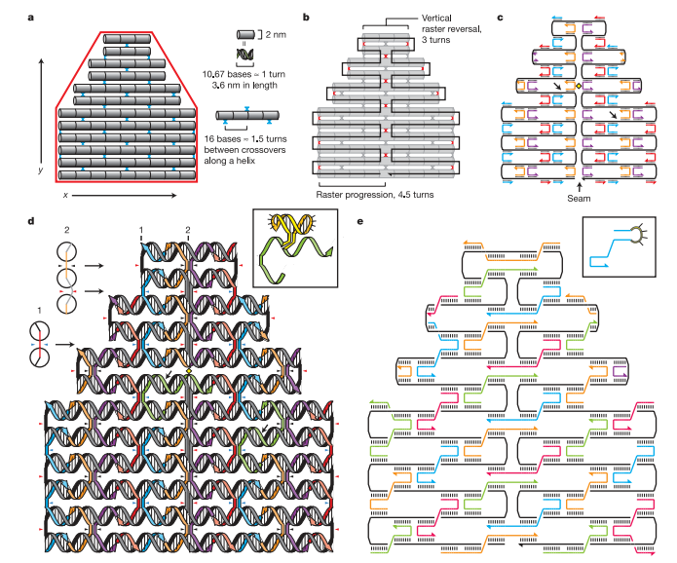
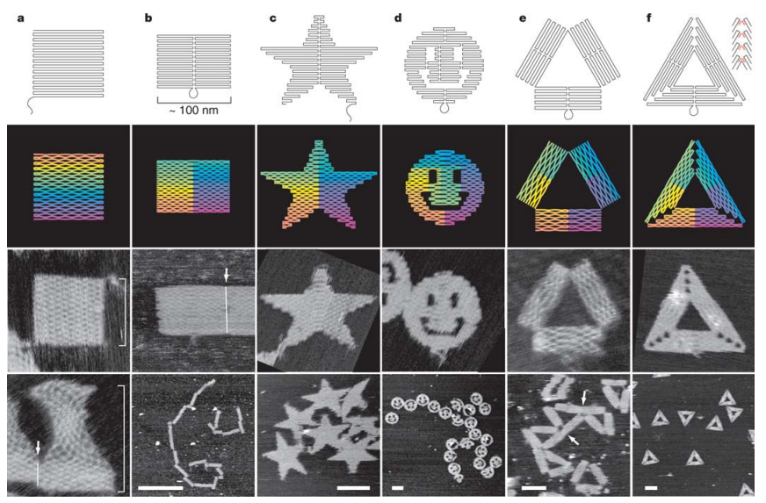
Rothemund DNA Origami
Paul W. K. Rothemund, NATURE , 440, 2006

Slide 2
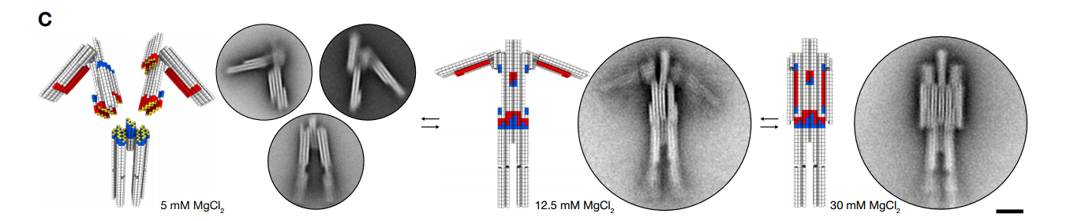
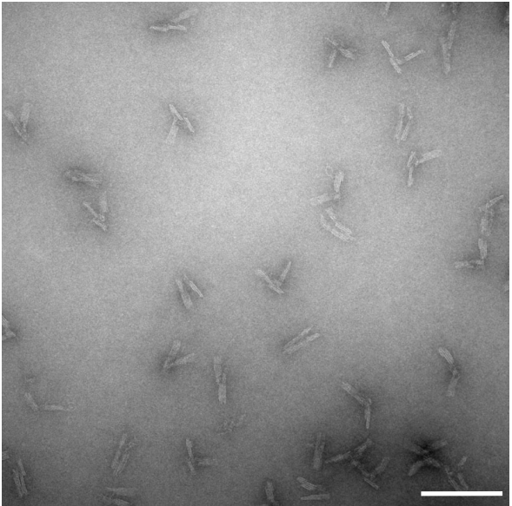
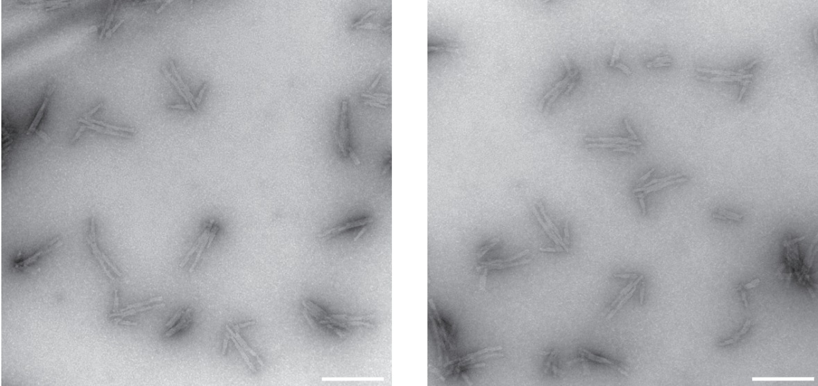
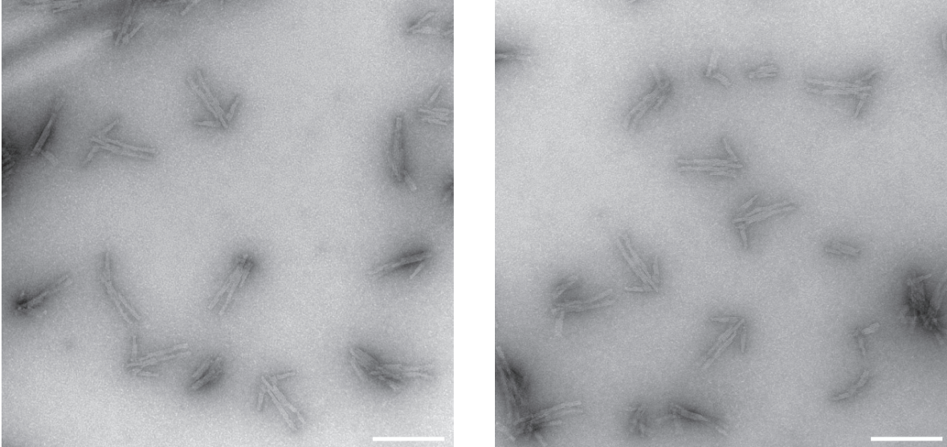
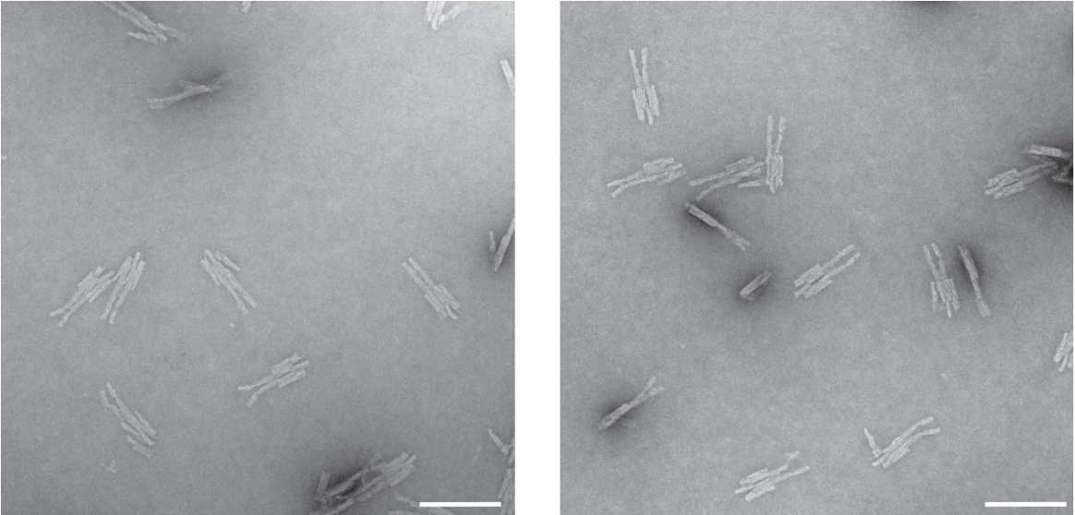
In 5mM MgCl₂ robot is disassembled into monomers
In 12.5 mM MgCl₂ robot is
assembled with open arms
In 30 mM MgCl₂ robot arms are being closed
Reversibly reconfigurable non–base pairing multistate DNA devices with arbitrary shapes.
Dynamic DNA devices and assemblies formed by shape-complementary, non–base pairing 3D components. H. Dietz, Science 2015

Slide 3
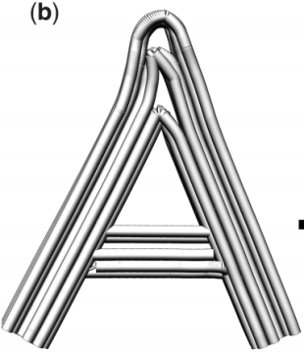
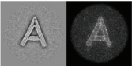
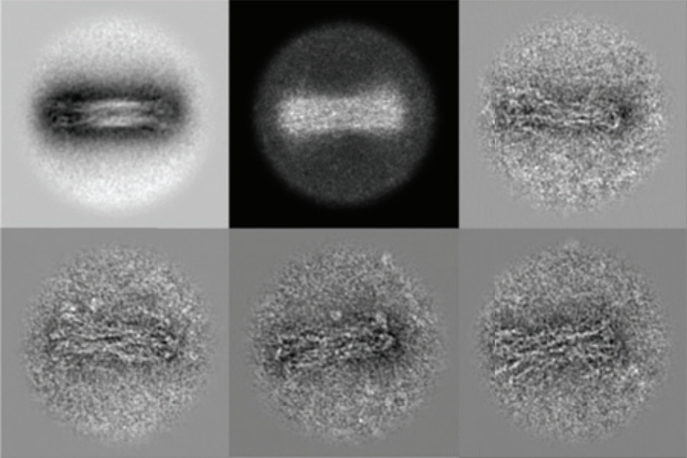
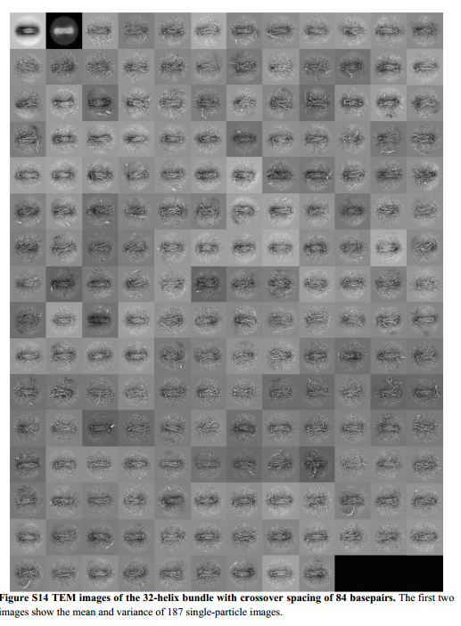
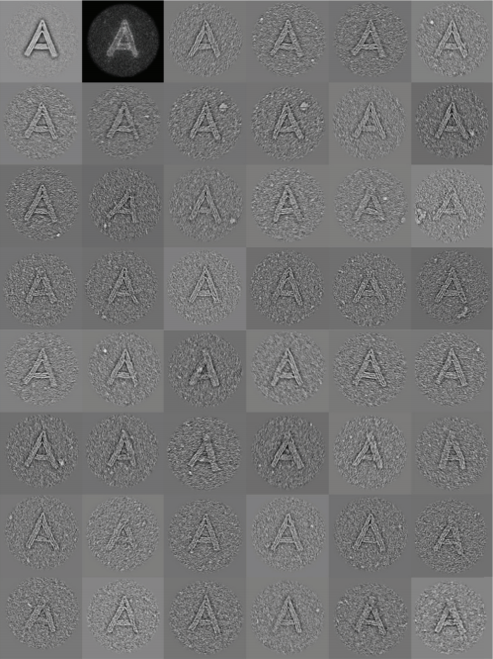
Imaging of Different Origami using TEM
Mean Image
Variance Image

Slide 4
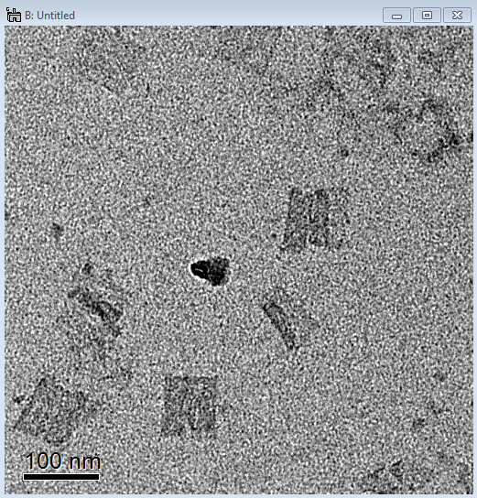
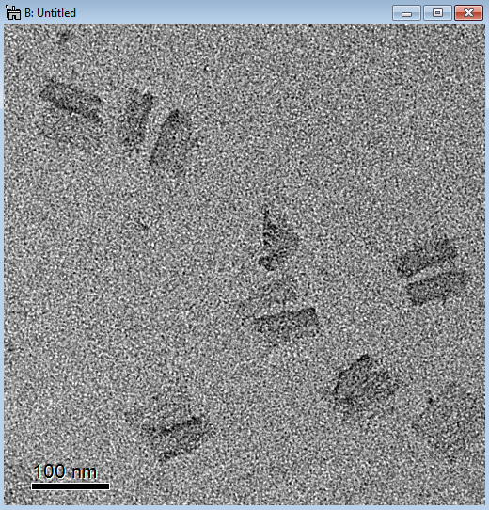
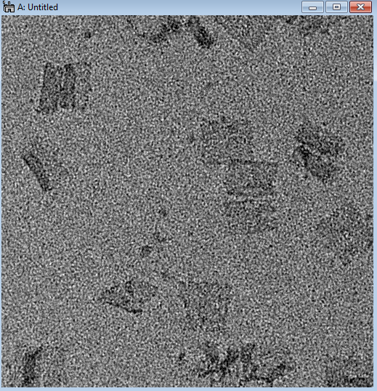
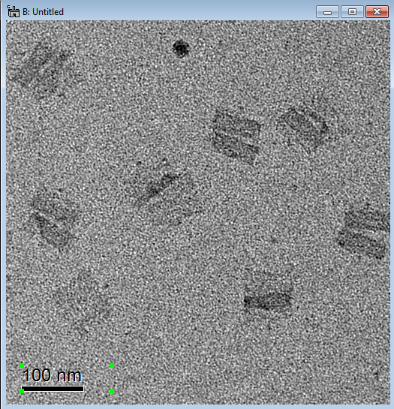
Characterization of Dimers from TEM Images
The third dimension in DNA Origami structure, Miran Liber
Double
Smeared
Butterfly
Width of both sides:
31.7±2.1 nm

Slide 5
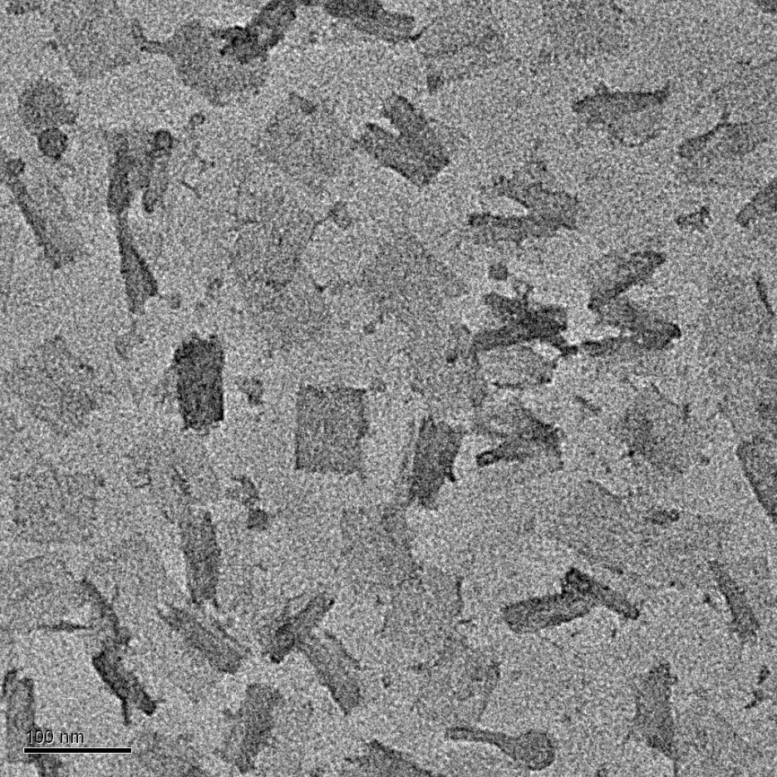
Characterization of Dimers from TEM Images
The third dimension in DNA Origami structure, Miran Liber

Slide 6
TEM Sample preparation protocol Multilayer DNA Origami Packed on Hexagonal and Hybrid Lattices, W.M. Shih, JACS, 2011
TEM studies. The TEM sample was prepared by dropping 3.5µL of sample solution on a
carbon-coated grid (400 mesh, Ted pella). Before depositing the sample, the grids were
negatively glow discharged for 45 seconds. After 2 minutes, the sample was wicked from
the grid by touching its edge with a piece of filter paper. Then the grid was touched with
a drop of 2 % uranyl formate solution and excess solution was wicked away with a filter
paper. Again the grid was touched with a second drop of uranyl formate solution for 20
seconds, and the excess solution was removed with a filter paper. TEM studies were
conducted using a JEOL JEM-1400 transmission electron microscope, operated at 80 kV
on bright field mode.

Slide 7
TEM Sample preparation protocol DNA Origami Gatekeepers for Solid-State Nanopores, H. Dietz, 2012
Particles were adsorbed on glow-discharged formvar-supported carbon-coated Cu400 TEM grids and
stained using a 2% aqueous uranyl formate solution containing 25 mM NaOH. Imaging was performed
using a Philipps CM100 electron microscopy operated at 100 kV. Images were acquired using a AMT
4x4 Megapixel CCD camera. Micrograph scale bars were calibrated using 2D catalase crystal lattice
constants as length reference. Imaging was performed at 28500x magnification.

